Slide 1
John Ferguson Capstone project

Slide 2
Test Overview
Security testing using the OWASP principals. User permissions, login authentication, and security of login information. Utilizing Postman, Wireshark, Bug Magnet and Ruby to conduct test.
Postman will be used to test what information is shown making API Calls.
Wireshark will be used to see what information is given during login attempts.
Ruby will be used for automating test cases.
Bug Magnet will be used to input data.

Slide 3
Test cases
Test Valid Admin logins
Verify rights for Admin logins
Login with incorrect credentials
Verify user information isn’t given
Use wireshark to verify information can’t be captured
Use API to verify user information

Slide 4
Automation challenges
t=Time.now.strftime("%d/%m/%Y %H:%M")
if browser.text.include? "zestT"
if browser.button(type: 'submit').disabled?
if browser.select(id: 'specialties').length == 0

Slide 5
defect
Pet Types list items set to randomize

Slide 6

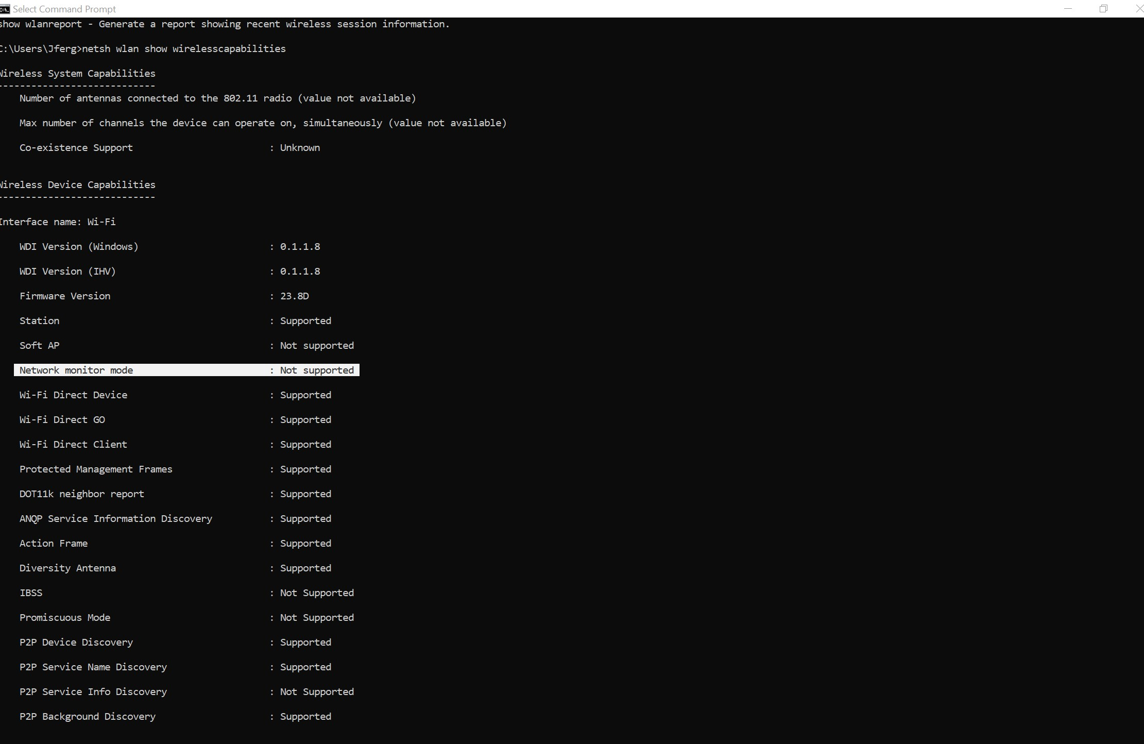
Self-Learning
Wireshark is a network packet analyzer. A network packet analyzer presents captured packet data in as much detail as possible.
Monitor Mode
Wireshark demonstration

Slide 7
Conclusion
https://github.com/Johnferguson1440/Class12Capstone.git

